Slide 1









ResQRelief
“Emergency Food Distribution System”
Because every crisis deserves a response!
Authors: Maryam & Malak
Supervisor : Mr.Hakam Nabulssi
Date : 30 / 07 / 2025
Course name : Computer Science Course Part B
Presentation template by

Slide 2


General description
100 %
99.9%
80 %
60 %
62%
In times of crisis, effective emergency food distribution can be the difference between hunger and hope!
40 %
45%
20 %
0 %
45 %
62 %
99.9 %
Waiting
time
Accuracy
of
the
resources
Completeness
Of the
data
Presentation template by

Slide 3


Problems
01
Food Distribution Issues & Online Data showing
02
Fixed Standards
03
Duplications ,Hard managements, unclear Data
04
No BACKUP
System
Presentation template by

Slide 4

How it works?
Presentation template by

Slide 5


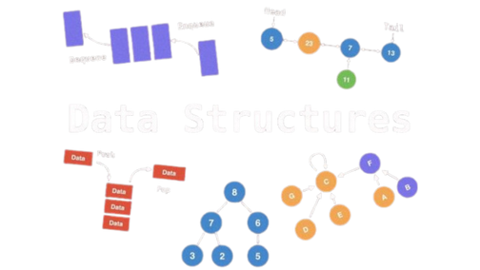

HashMap
ArrayList
Linked list
Priority Queue
HashTable
Libraries
Development environment
Programming language
Javax.swing
Java.awt
Java.io
Java.util
Javax.mail
Java.awt.event(FocusAdapter/FocusEvent)
Java.util.regex(Pattern/Matcher)
Presentation template by

Slide 6

Challenges & SDLC
Priority Algorithm
Desktop shortcut
Using queue methods
Handling Java Swing
Verification System
Dealing with large text files.
Achieving synchronization between
data structures { HashTable – HashMap }
Presentation template by

Slide 7


Achievements & Lessons
Developing a user-friendly system
database system, with Implementing changes
Authentication & Verification System
Building a successful priority algorithm for sorting
Maintain accurate records, including backup file
Working with libraries
Desktop shortcut
Dealing with multiple Data-Structures & AI Tools
Presentation template by

Slide 8


Thanks for listening!
RQR
Because every crisis deserves a response!
Maryam Hassan & Malak AbedAllah
Inbox - efdsfp19@gmail.com – Gmail

Slide 9

VIDEO !
BEHINDB THE SCENE
Presentation template by

